Slide 1
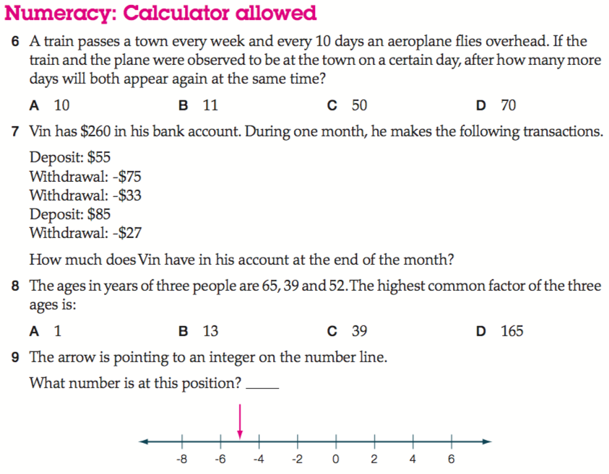
Naplan Starter Questions

Slide 2
My Numbers and Operations Interactive Notebook
$$+$$
$$23$$
-1
$$−$$
$$×$$
$$÷$$
Name:
Class:
Teacher:
Semester 1
Term 1
$$5^{2}$$
$$0$$
$$−10$$

Slide 3

Interactive Notebooks!
Cover Page
Contents Page
Glossary
24/7/30
EQ
Questions
Notes
Summaries
Work page
Presentation!!!
Your book, your responsibility!

Slide 4


Slide 5
Contents
Glossary or Formula Page
Page
Date
Description
2
3

Slide 6

Learning Intentions
To learn a bit about the history of number systems✓
To further expand and solidify our mathematical vocabulary✓
To further learn the value of the place system ✓
To compare, order, add and subtract integers✓
WICOR

Slide 7

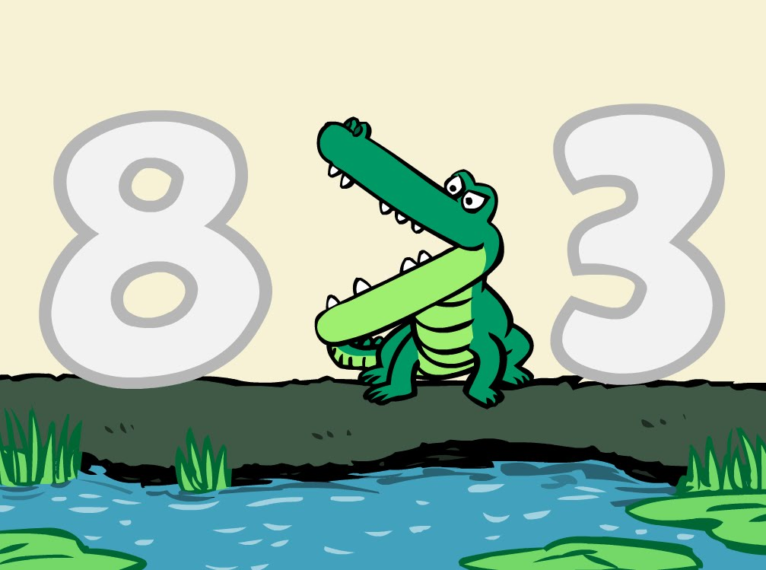
24
7
30
Unit Review
Date
EQ – What have we learned over the past two weeks?
Integers are:
Positive and negative whole numbers, including zero
We use a number line to visually order integers
For any two different places on the number line, the integer on the right is greater than the integer on the left.
Mathematically, we show greater than and less than using
the > and < symbols. The smaller number always eats
the bigger number. Ex: 8 > 3
Summary

Slide 8

Quick Revision
1.
2.
3.

Slide 9
24
7
30
Unit Review
Date
EQ – What have we learned over the past two weeks?
The following mental strategies help us solve calculations in our heads:
Strategy 1 – Make easy numbers. Use the commutative and associative laws to shuffle numbers in ADDITION AND MULTIPLICATION problems to make easy numbers
Strategy 2 – Use the distributive law. This law allows us to multiply a large number by splitting it into 10s and 1s (or 100s, 10s, 1s)

Slide 10

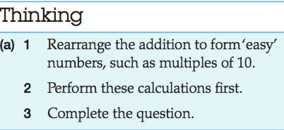
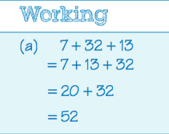
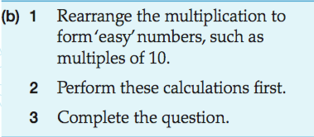
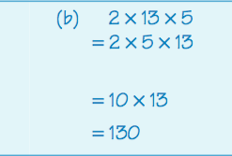
24
7
30
Unit Review
Date
EQ – What have we learned over the past two weeks?
Strategy 1 – Ex:

Slide 11

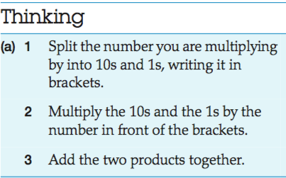
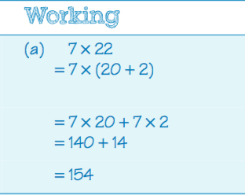
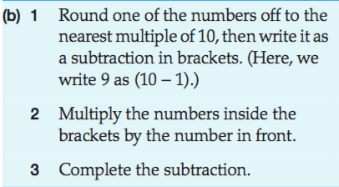
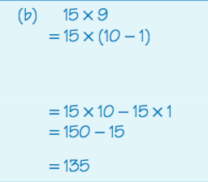
24
7
30
Unit Review
Date
EQ – What have we learned over the past two weeks?
Strategy 2 – Ex:

Slide 12
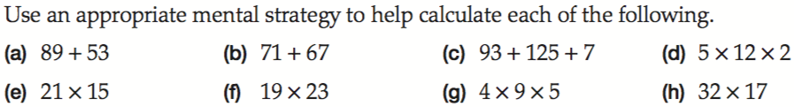
Quick Revision

Slide 13
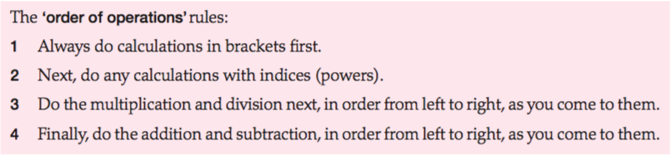
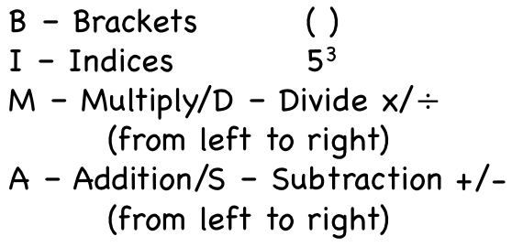
24
7
30
Unit Review
Date
EQ – What have we learned over the past two weeks?
Order of Operations/BIMDAS
aka BIMDAS

Slide 14
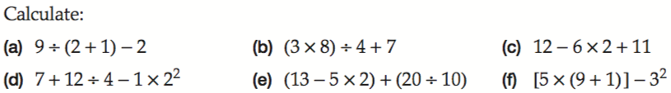
Quick Revision

Slide 15
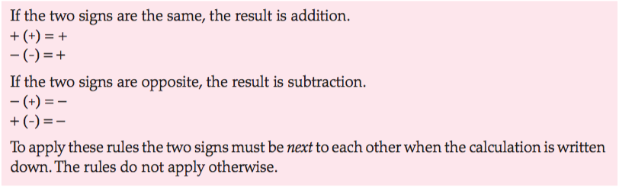
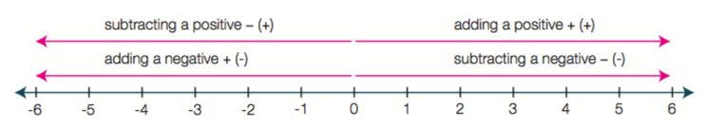
24
7
30
Unit Review
Date
EQ – What have we learned over the past two weeks?
Adding and Subtracting Integers

Slide 16
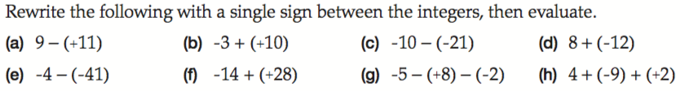
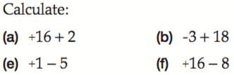



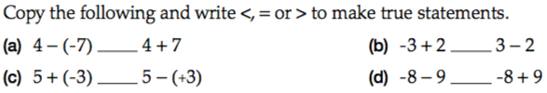
Quick Revision

Slide 17
Homework
Mathspace Mini-Test Review task
The first page of your Learning Log (you will submit your writing task after your mini-test

